Slide 1
Chapter 3: Principles of Software Architecture
Session II: Fundamentals of Requirements Engineering

Slide 2
Session’s Agenda
Software Architecture Process
  Understand and Evaluate Requirements
  Design the Architecture
  Evaluate the Architecture
  Document the Architecture
  Monitor and control implementation
Requirements Engineering
  Elicitation
  Analysis
  Specification
  Validation
What’s next..

Slide 3
Software Architecture Process
On a larger scale, the process for creating software architectures can be executed using the following tasks:
  Understand and evaluate requirements
  Design the architecture
  Evaluate the architecture
  Document the architecture
  Monitor and control implementation
Software architects spend a great deal of time working with software requirements.
  Even after requirements are specified, software architects find themselves going back and forth between requirements and design.
  In some cases, architects are completely immersed in the requirements phase, playing a key role in the specification of requirements.

Slide 4
Understand and Evaluate Requirements
Requirements engineering
  The discipline within software engineering that is concerned with the systematic approach to requirements specification, mainly through the following activities:
    Elicitation
    Analysis
    Specification
    Validation
Similar to the design phase, the requirements phase can be broken down into well defined activities
Software Engineering Life-cycle Phase
Requirements
Design
Testing
Elicitation
Architecture
Phase Activities
Analysis
Detailed Design
Specification
Validation

Slide 5
Understand and Evaluate Requirements
Elicitation
  Activity that deals with identifying stakeholders, uncovering what the customer needs and wants, and with determining the non-functional requirements.
  Begins by identifying all sources of information that can be used to generate requirements.
    These vary from project to project and can provide bias information to shape the system in a way that addresses their particular needs.
  Different sources can have similar but different visions for the system.
    Common sources of requirements include:
      Stakeholders
      Goals
      Domain knowledge
      Operational and organizational environment
Elicitation Techniques
  Interviews
  Facilitated meetings
  Observation
  Scenarios

Slide 6
Understand and Evaluate Requirements
On eliciting requirements using Scenarios
  A popular approach for eliciting requirements.
  Allow designers to present stakeholders with storylines about different behaviors that the system is expected to provide.
  These storylines are born out of the perceived expected behavior by the designer and refined and validated through stakeholders’ reviews.
  They provide a valuable means for:
    Establishing a framework for eliciting requirements
    Identifying major system functions and details of the software
    Providing initial insight into the required testing of the software.
In UML, scenarios are grouped by use cases.
  For each use case, one or more scenarios—one for the main flow of events and other for alternate scenarios—are created to document the expected system behavior and deviations from its main flow of events.
  Scenarios represent instances of use cases, so there is one-to-many relationship between use case and scenarios.
  Since there are no universally accepted method for documenting scenarios, they can be found in the following format:
    Paragraphs, numbered list, tabular or graphical form, etc.
  Without scenarios, use cases provide limited benefits.

Slide 7
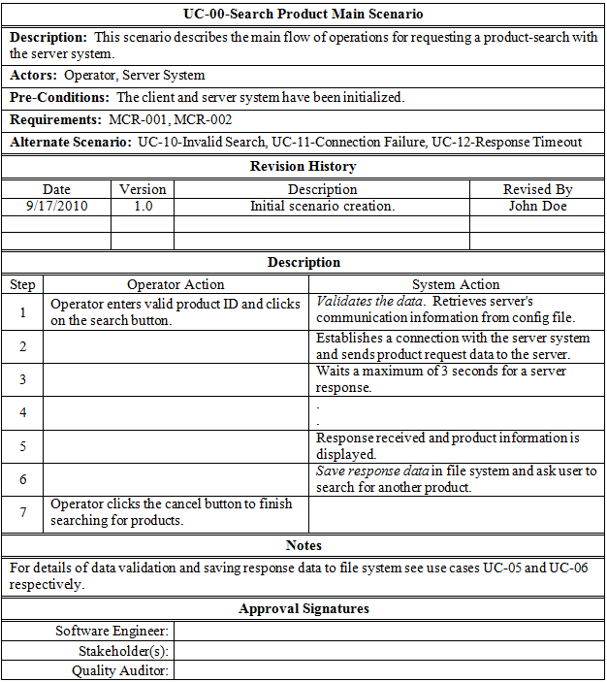
Scenario Name and Number
Scenario Description and other Information
Quality requirements are discovered using scenarios
Important:
Scenarios are NOT thrown away after design! They are eventually transformed into Unit Test Cases!
Steps included in the scenario, classified as operator action and system response.
Other important information regarding this scenario
Scenarios need to be approved!
Search Product’s Main Scenario
Search Product Use Case
Search Product
Operator

Slide 8
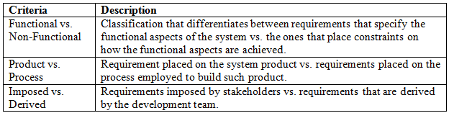
Understand and Evaluate Requirements
Analysis
  Requirements are analyzed in their raw form to address issues such as requirements that are contradicting, incomplete, vague, or just wrong [1].
  Allows architects to clear the air in regard to what needs to be done before devising more detailed designs.
  The following tasks can be performed during analysis:
    Requirement classification
    Requirement prioritization
    Requirement negotiation
    Conceptual modeling
Requirement classification
  Performed for identifying the nature of each requirement
    Functional vs. non-functional
    Product vs. process
    Imposed vs. derived

Slide 9
Understand and Evaluate Requirements
Requirement prioritization and negotiation
  Helps identify the most important functions of the software system.
  When done properly, it can help refine the projected schedule by determining which requirements need to be processed first.
  Can be used to determine different builds of the software
  Can help during negotiation when conflicts between requirements are identified
Conceptual modeling
  Conceptual models are created to further identify the requirements by understanding their context, discovering the bounds of the software system, and conceptualizing how the system interacts with its environment.
  In many projects, this is where architectural design begins, since system decomposition is essential to developing effective conceptual models.

Slide 10
Understand and Evaluate Requirements
Specification and validation
  Activity where the results of elicitation an analysis are formally captured and documented in an appropriate format for the use and review of all stakeholders.
  The format of the specification varies depending on the developing organization or project; however, it is typically produced as a document, or its electronic equivalent, and is referred as the software requirements specification.
When specifying requirements, it is important that each requirement exhibit certain characteristics desired for designing successful systems. Requirements must be:
  Specific
  Correct
  Complete
  Consistent
  Attainable
  Verifiable

Slide 11
Understand and Evaluate Requirements
On being specific,
  Requirements need to be specified in a clear, concise, and exclusive manner.
  Clear requirements are not open to interpretation; unclear or ambiguous requirements lead to incorrect designs, incorrect implementations, and deceptive validation during test.
  Concise requirements are brief and to the point and are therefore easier to understand.
  Exclusive requirements specify one, and only one thing, making them easier to verify.
For example, consider the following statement:
The software needs to provide an easy-to-use interface; that is, it must be usable.
This statement provides important information to begin thinking about what the customer wants and expects from the software system.
For example, a console-based interface may be highly usable for developers, but not for customers, which may prefer a graphical user interface!
However, in its current form, this statement is too generic to use as basis for design, construction, and verification of the software system.
Designing based on different interpretations of this statement may entail sacrificing other functions that may be important to customers and users!

Slide 12
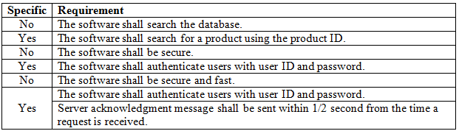
Understand and Evaluate Requirements
Example of specific and nonspecific requirements:
Search the database for what?
What does this mean?
Secure and fast?
These two requirements are specific and provide the information required to determine what secure and fast mean!

Slide 13

Understand and Evaluate Requirements
On being correct,
  Requirements need to be correct in the sense that they must accurately describe a desired system function.
  In some cases, correctness of requirements is easily identified; in others, it is not.
  Laplante [1] presents an example based on requirements for a computer security system for which it requires users to log on using a unique combination of user ID and password.
    In this case, when users attempt to log on using an already existing user name or password, the system is required to reject the attempt, therefore giving insight into someone else’s logon information.
  Incorrect requirements can lead to incorrect or undesired behavior.
Register
Login Error!
Display error, per specification
Username:
Error: You must use a
unique combination of
user ID and password!
user123
Password:
pwd123
OK
user123 and pwd123 combination
is taken! What happens if I try to
log in using this combination?
Login
Attempt to register
Yes, that is right. The system has given away someone else’s logon information!

Slide 14
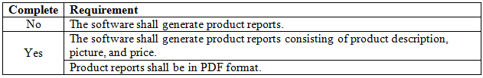
Understand and Evaluate Requirements
On being complete,
  Requirements must be complete both individually and as collective set.
    This means that each requirement should be specified thoroughly so that it absolutely describes the functions required to meet some need.
    Collectively, requirements need to provide complete specification of the software’s required functionality in the software requirements specification (SRS).
  Incomplete requirements lead to incomplete designs, which in turn leads to incomplete construction of the software system.
  Requirements that are complete help clarify questions during construction and testing by providing information necessary to disambiguate or prevent misinterpretations of required functionality.
  Completeness is hard because it is not always obvious or it is sometimes too difficult to determine when information is missing [1].
Notice how the original requirement is broken into two complete requirements!
This is a good requirement in the sense that it is specific and correct.
However, if we know the requirements for product reports, then a complete version of this requirement specifies this information. This help disambiguate the notion of a product report so that it can be implemented easily in code.

Slide 15


Understand and Evaluate Requirements
On being consistent,
  Requirements are consistent when they do not preclude the design or construction of other requirements.
On being attainable,
  Requirements that are unattainable serve no purpose.
  Attainability can be determined for both product and process.
On being verifiable,
  Perhaps the most obvious desirable characteristic of requirements.
  Requirements that cannot be verified cannot be claimed as met.
  Inability to verify requirements point to a serious flaw early on in the development process
Can you meet this requirement today?

Slide 16
What’s next…
In this session, we presented fundamentals concepts of requirements engineering, and provided enough information to successfully create good requirements.
In the next session, we’ll discuss how to design the software architecture using the popular 4+1 View Model, which includes
    Logical view
    Development View
    Process View
    Physical View
    User View

Slide 17
References
[1] Laplante, Phillip A. Requirements Engineering for Software and Systems. Boca Raton, FL: Auerbach Publications, 2009.

